Slide 1

Concrete strength prediction model

Slide 2
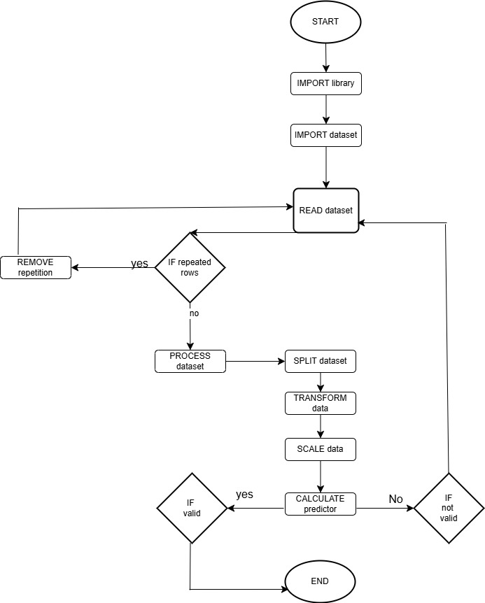
Flow Chart

Slide 3

Data Cleaning
The data set was cleaned by renaming some of the feature columns to make them more readable, and by checking for and dropping any duplicate rows.

Slide 4
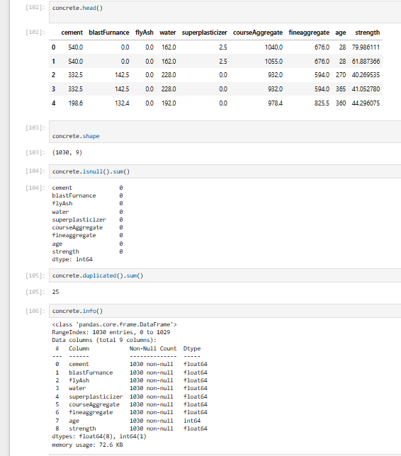
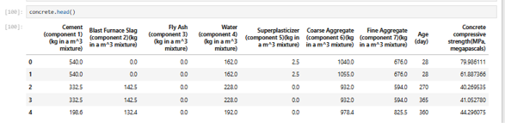

Slide 5
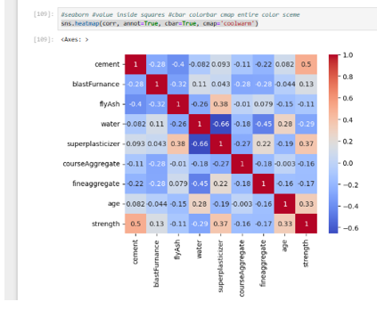

Slide 6
Data Preprocessing
The data set was preprocessed by performing several steps, such as handling missing values, scaling the data, and splitting the data into training and testing sets.

Slide 7
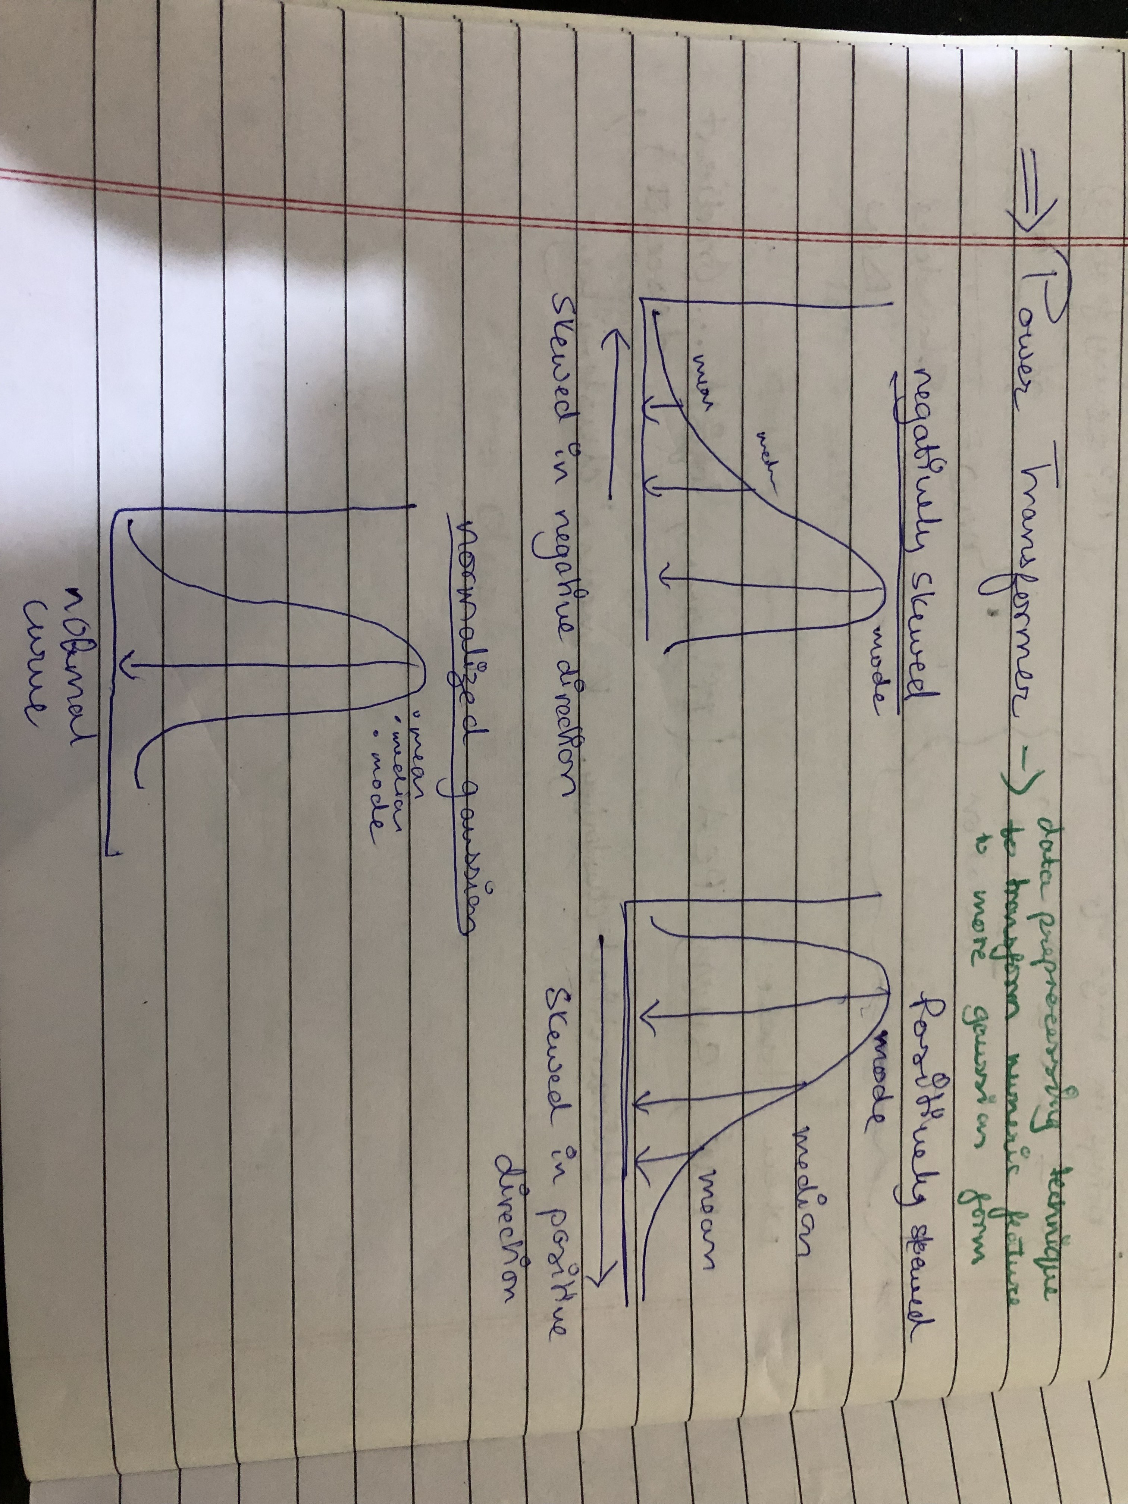

Slide 8
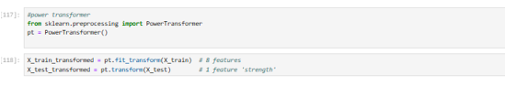
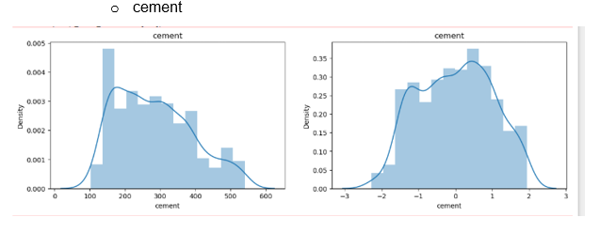
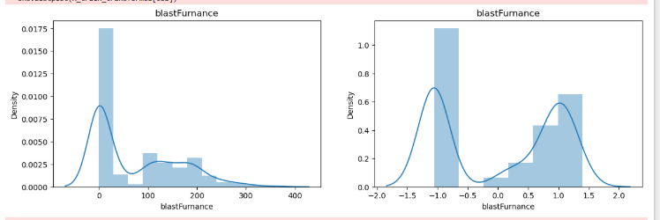
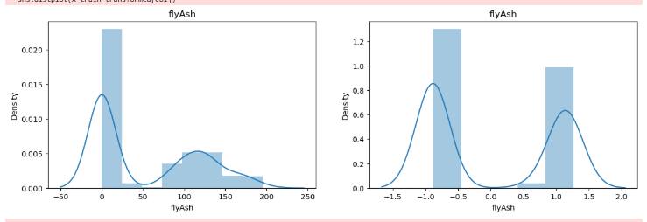
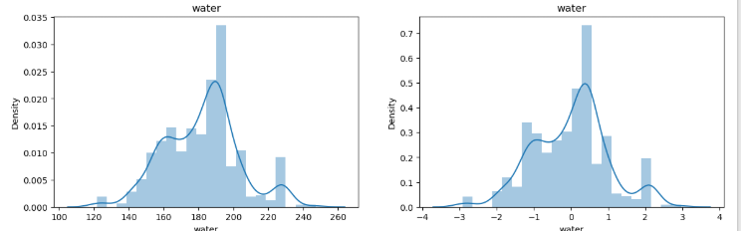
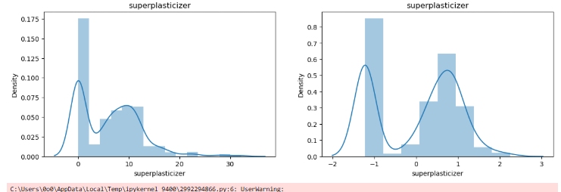
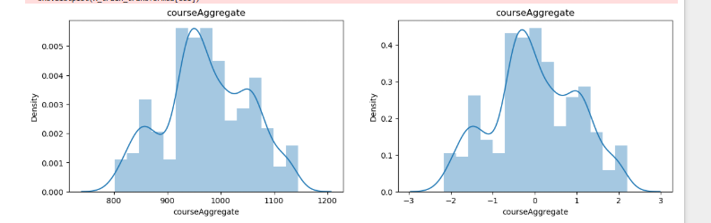

Slide 9
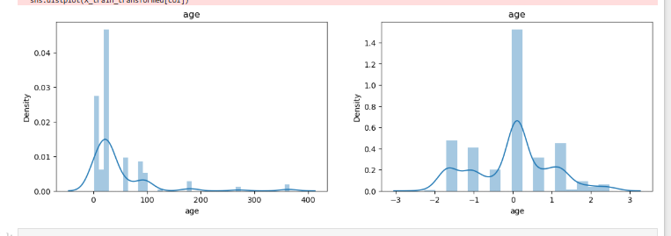
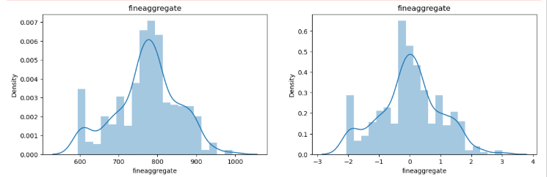

Slide 10

Scaling the Data
The data was scaled using the StandardScaler function from the sklearn.preprocessing library to ensure that all features were on the same scale and to prevent any single feature from dominating the model.

Slide 11
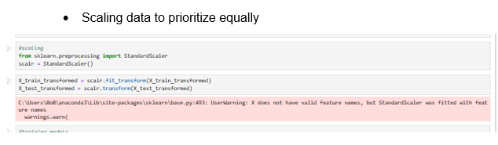

Slide 12
Splitting the Data
The data was split into training and testing sets using the train_test_split() function from the sklearn.model_selection library.

Slide 13
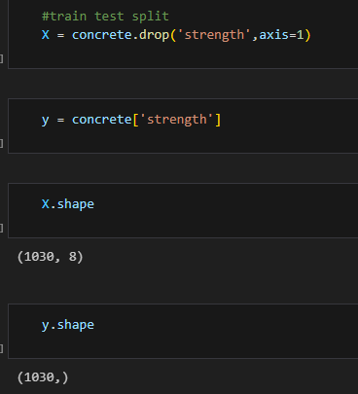

Slide 14

Model Selection
Several models were trained and tested on the data set, including Linear Regression, Lasso Regression, Ridge Regression, Decision Tree Regression, and XGBoost Regression. The model with the best performance was selected based on various evaluation metrics, such as mean squared error (MSE), mean absolute error (MAE), and R-squared score.

Slide 15
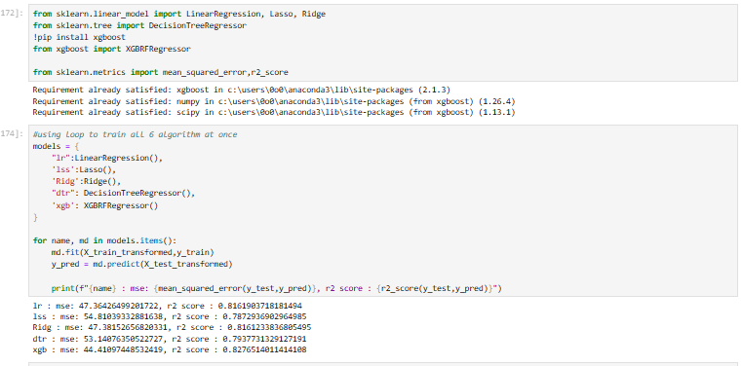

Slide 16
Model Evaluation
The selected model was evaluated using the test data set, and its performance was analyzed using various evaluation metrics. The results were visualized using various plots, such as scatter plots and residual plots.

Slide 17
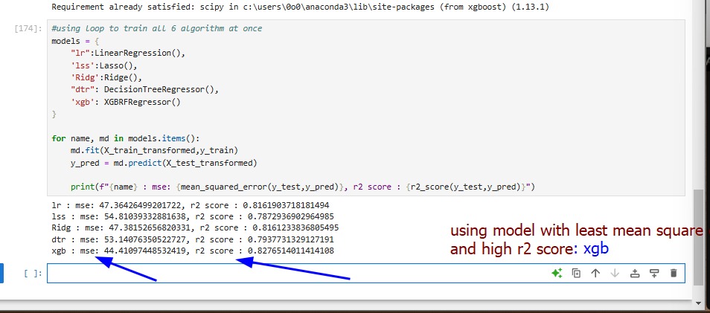
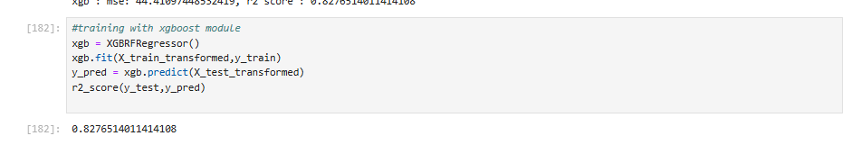

Slide 18
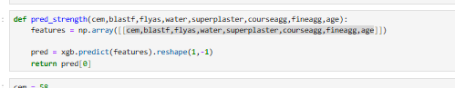
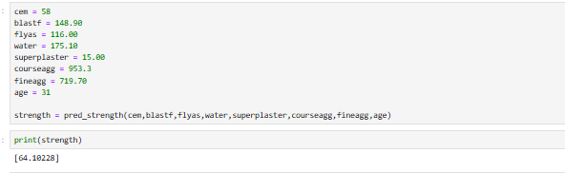

Slide 19
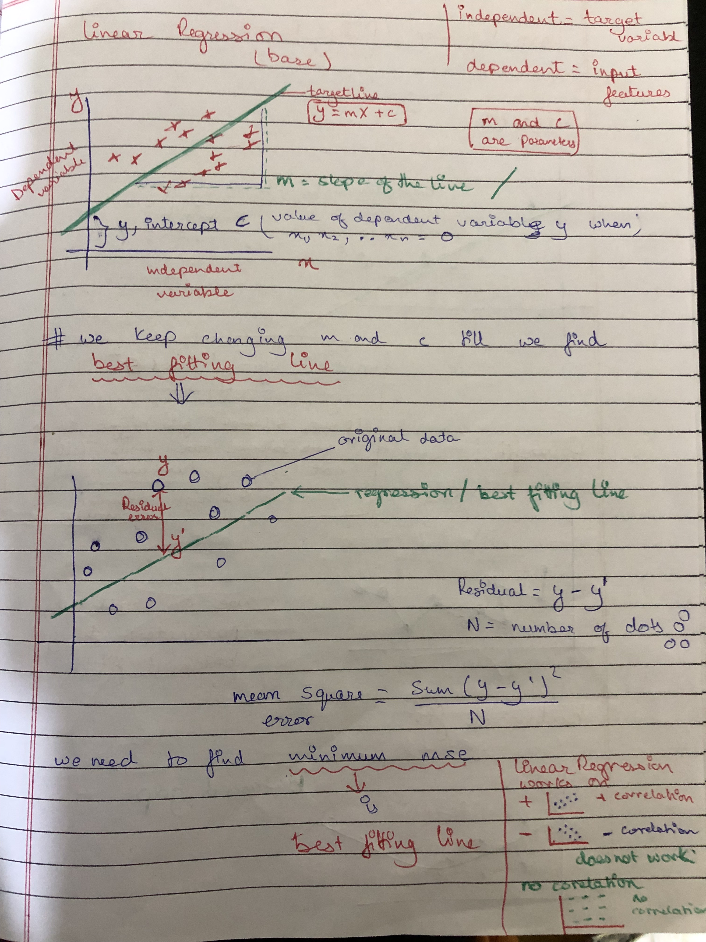

Slide 20
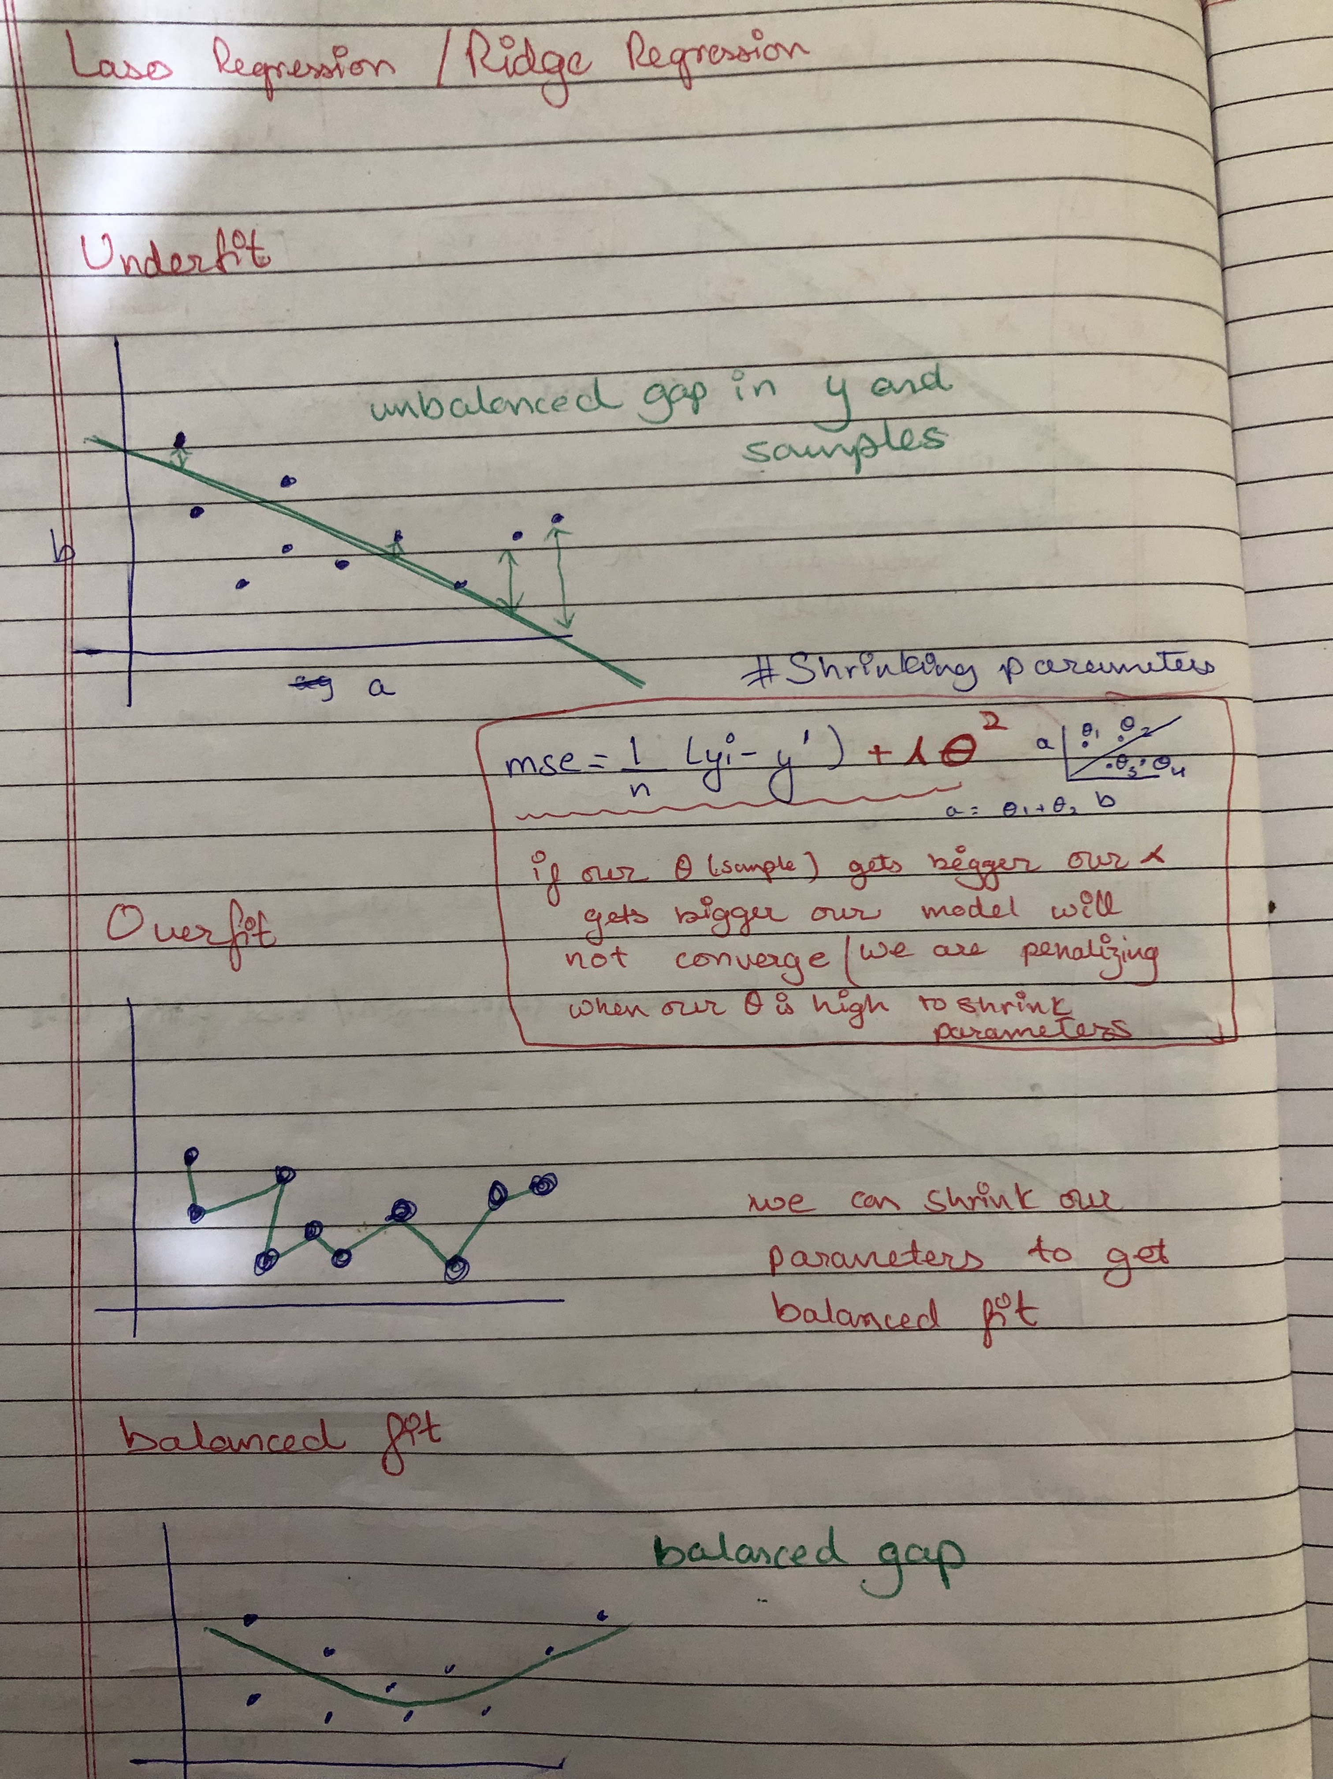


Slide 21
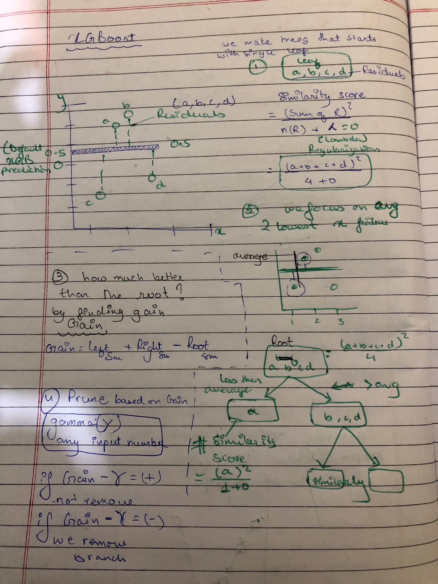

Slide 22
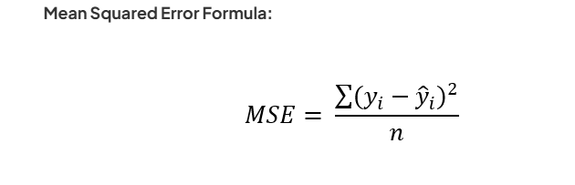
Mean Squared Error
Mean squared error (MSE) is a measure of the error in prediction algorithms. This statistic quantifies the average squared variance between observed and predicted values. When there are no errors in a model, the MSE equals 0. A model's worth increases in proportion to the degree of error it contains.

Slide 23
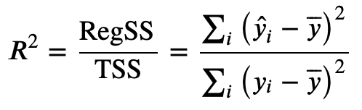
R2 Score
Coefficient of Determination or also known as R2 score score is used to evaluate the performance of a linear regression model. It is the amount of the variation in the output dependent attribute which is predictable from the input independent variable(s). It is used to check how well-observed results are reproduced by the model, depending on the ratio of total deviation of results described by the model.

Slide 24

Conclusion
In conclusion, this project aimed to build a model that could predict the compressive strength of concrete based on its components. The data set was explored, cleaned, preprocessed, and used to train and test various machine learning models. The best model was selected based on its performance on the test data set, and its performance was analyzed using various evaluation metrics. The final model can be used to predict the compressive strength of concrete and can be helpful in the construction industry.

Slide 25

Research and evidence

Slide 26


Slide 27


